Slide 1

Using videos for guidance
STRATOS meeting November 2021
Rolf H.H. Groenwold
TG 2 / knowledge translation panel
Notes:
Dear colleagues,
I would like to start by apologizing that I cannot be present at today’s meeting. At the same time, I think it provides an excellent opportunity to show what can be achieved using simple videos, which are – in my view – just one of many ways of achieving the ambitions of the STRATOS initiative.

Slide 2

STRATOS objective
“To provide accessible and accurate guidance in the design and analysis of observational studies. The guidance is intended for applied statisticians and other data analysts with varying levels of statistical education, experience and interests.”
Notes:
Although our objectives are crystal clear, the means by which we hope to achieve those ambitions are not specified. So far, many STRATOS output has been in the form of journal papers and workshops.

Slide 3


STRATOS videos ?
Notes:
Another format for dissemination of guidance on statistical methods could be videos.

Slide 4
How things started
Short message (70 secs = ~250 words)
Aimed at clinicians
Animated powerpoint + voice-over
Approx. 25 different topics
    P-value
    Confidence intervals
    Publication bias
    Confounding
    Regression to the mean
    Missing data
    etc
Notes:
I would like to share my personal experience. I was asked by the Dutch Journal of Medicine, which by the way is one of the oldest medical journals in the world, to develop short explainer videos about basic methodological topics aimed at their clinical readership. Here you see a screenshot of the video about p-values.

Slide 5
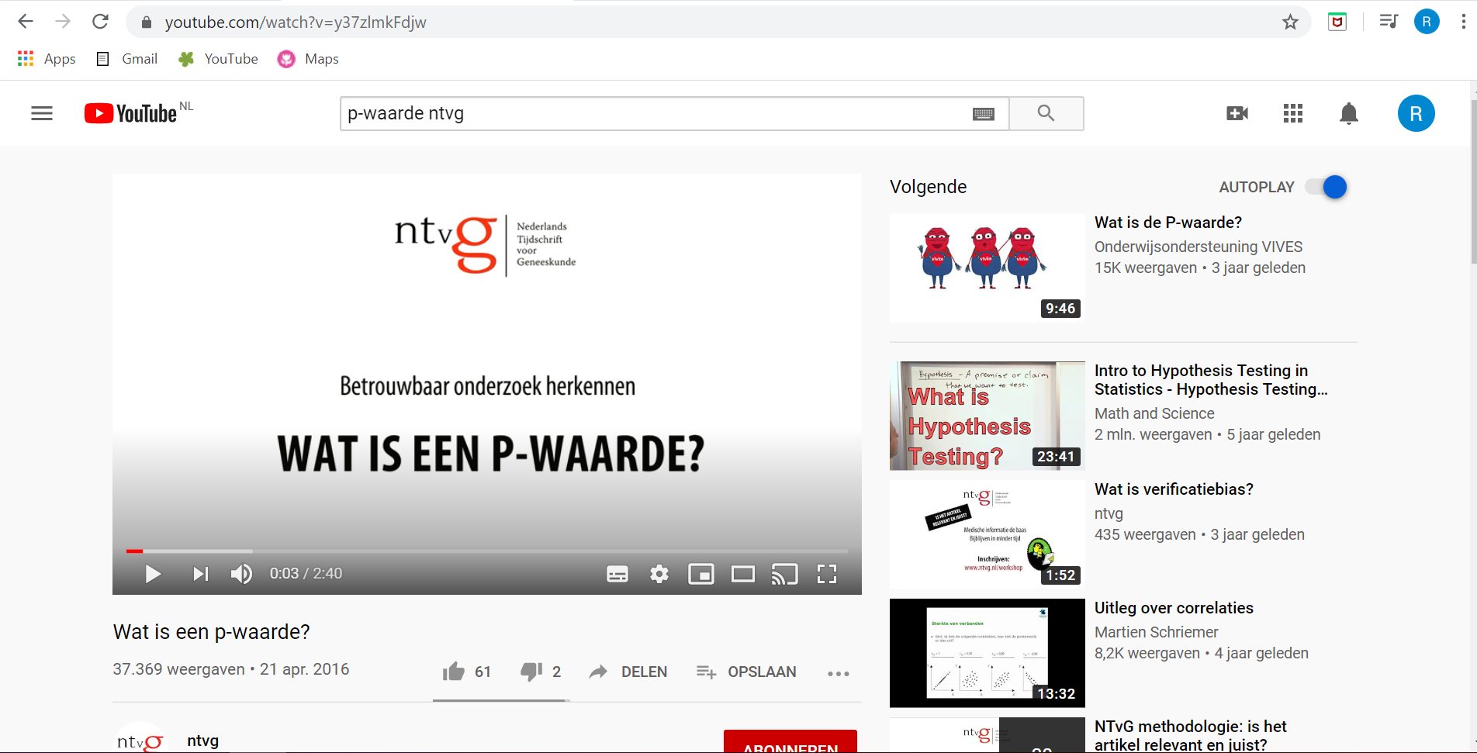
How things started
Views:
P-value: >56K
Confidence interval: >32K
Confounding: >17K
(note, videos are in Dutch)
Notes:
These videos were put on a public youtube channel, and have – I think – received quite some attention, with over 50 thousand views for the video on p-values.

Slide 6
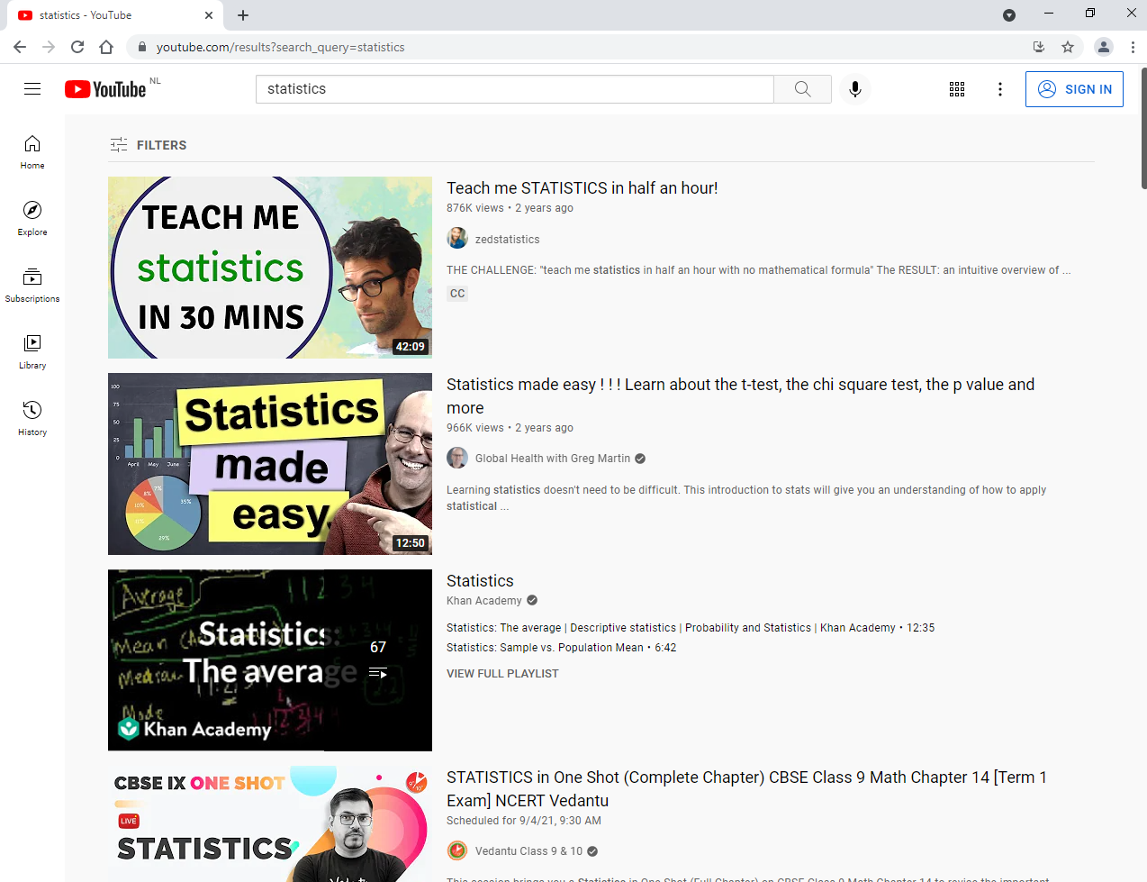
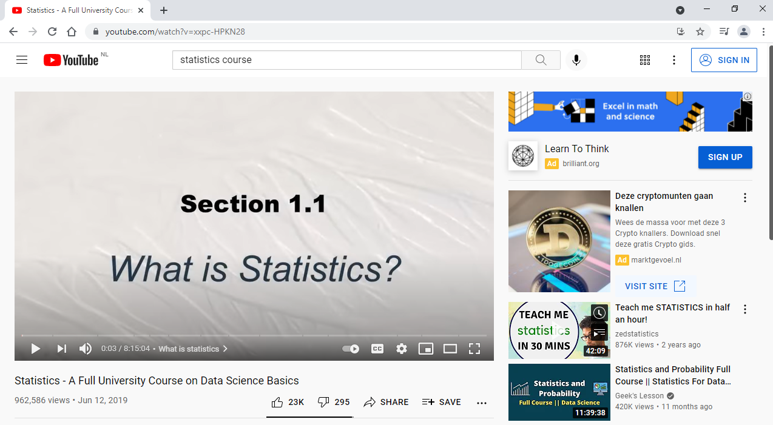
Youtube search
Notes:
You may wonder why we did not simply refer to youtube videos made by others. Well, indeed, youtube is full of videos on statistics, but I think not targeting the viewers we had in mind. And importantly, also not targeting the viewers that STRATOS probably has in mind.

Slide 7
STRATOS videos ?
Idea:
Short message (< 3 minutes)
Aimed at level 1 audience
Format:
Short
Informal
Motion / continuous visual flow
First Topics:
Categorisation of continuous predictors (TG 2)
Modelling continuous predictors (TG 2)
Measurement error (TG 4)
Notes:
We therefore decided to just give it a try for STRATOS too. Keeping in mind that we wanted to communicate relatively short messages aimed at a level 1 audience, we started with essentially animated power point presentations with voice-over. A few topics are close to being finalized and I’m happy to share those with people who are interested.

Slide 8
Our experiences
  Think about the audience!! (and ask for feedback throughout development process)
  Script everything
  The shorter the better
  Don‘t mind redoing your recordings (another reason why you want to keep it short ;-) )
  Don‘t underestimate time investment
  It‘s fun and rewarding and even apparently simple topics may spark a discussion
Notes:
For now, I would like to focus on the experiences we had so far, which should be considered as my personal advice to you. If you don’t think it is worthwhile, don’t start, because this is not something you do if you only have a few minutes to spare. But if you enjoy creating helpful guidance that potentially can be view by thousands, then I think it's a wonderful way to contribute to the ambitions of STRATOS.

Slide 9

Next steps
r.h.h.groenwold@lumc.nl
Notes:
I would like to end with an offer, that I hope you can’t refuse. Does your topic group consider developing STRATOS explainer videos too, then I would be very much willing to help and support that. And, obviously, if you want to learn more about developing videos and some of the technicalities, do send me an email and – on behalf of the knowledge translation panel – I will try to help. Thanks for your attention, and if you’re wondering how much time it took me to develop this video….

Slide 10

Notes:
… the answer is 45 minutes.

